Slide 1
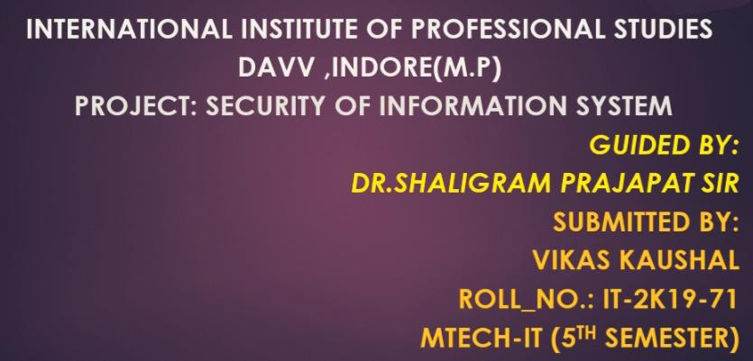
INTERNATIONAL INSTITUTE OF PROFESSIONAL STUDIES
DAVV ,INDORE(M.P)
pRoject: security of information system
Guided by:
Dr.shaligram Prajapat sir
Submitted by:
Vikas kaushal
Roll_no.: IT-2K19-71
MTECH-IT (5th semester)

Slide 2
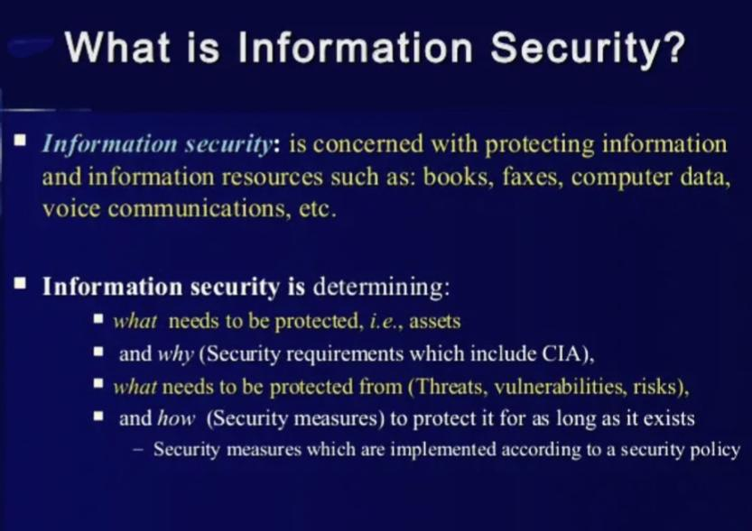

Slide 3
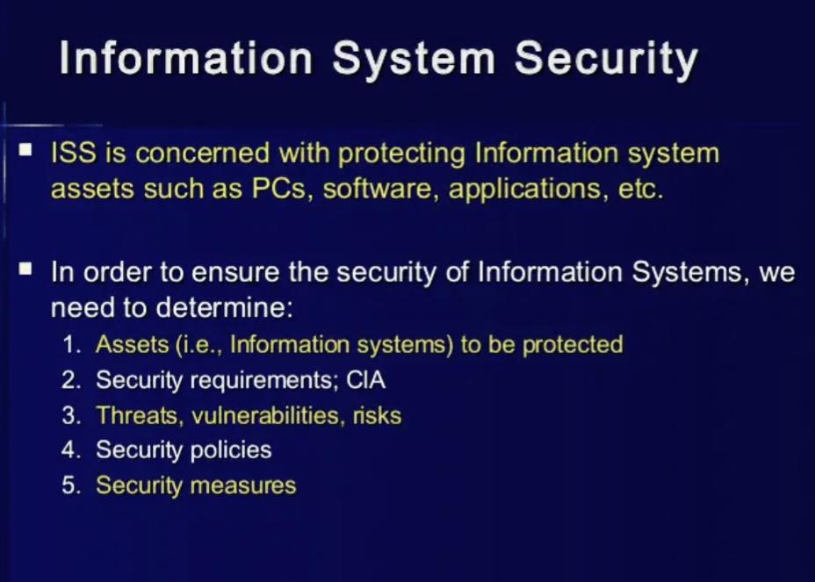

Slide 4
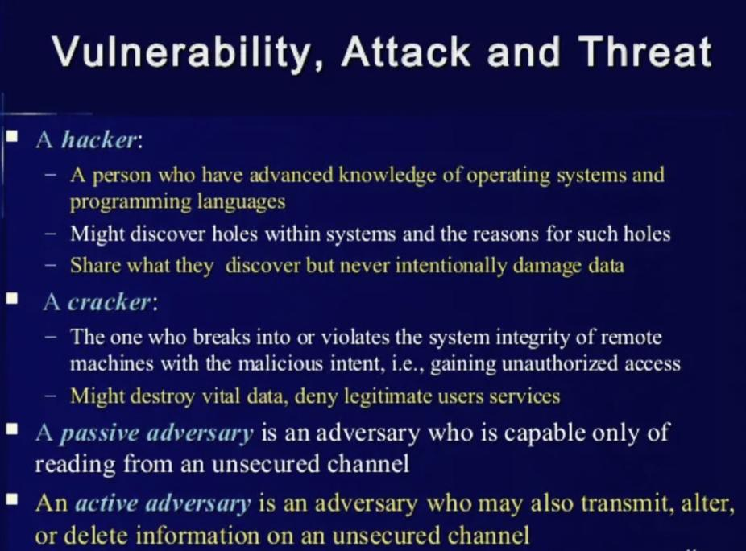

Slide 5
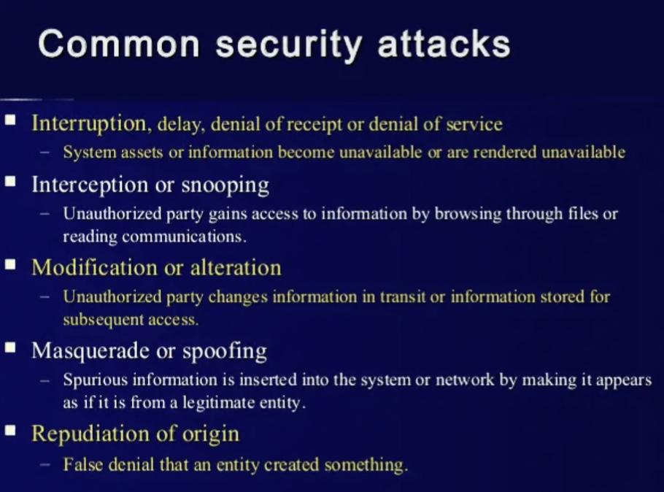

Slide 6
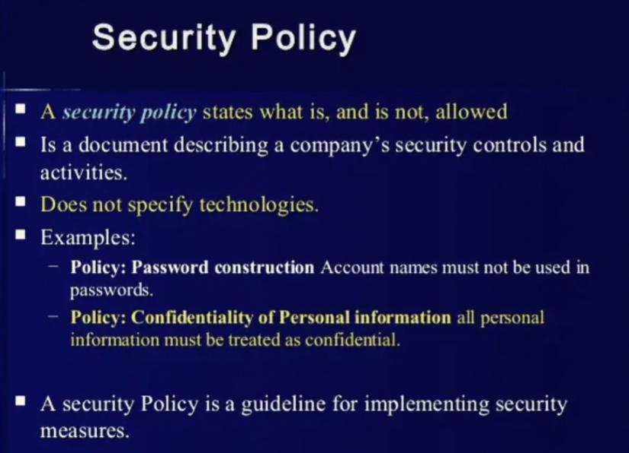

Slide 7
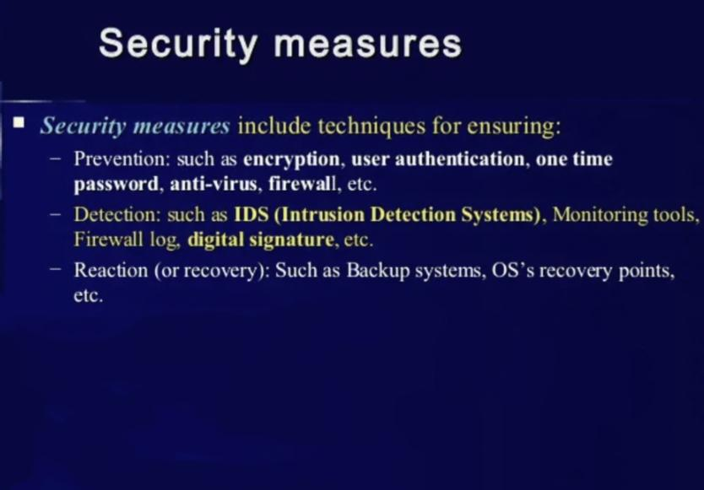

Slide 8
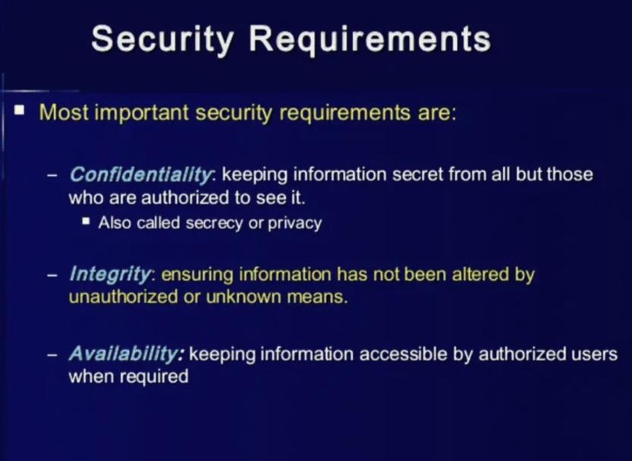

Slide 9
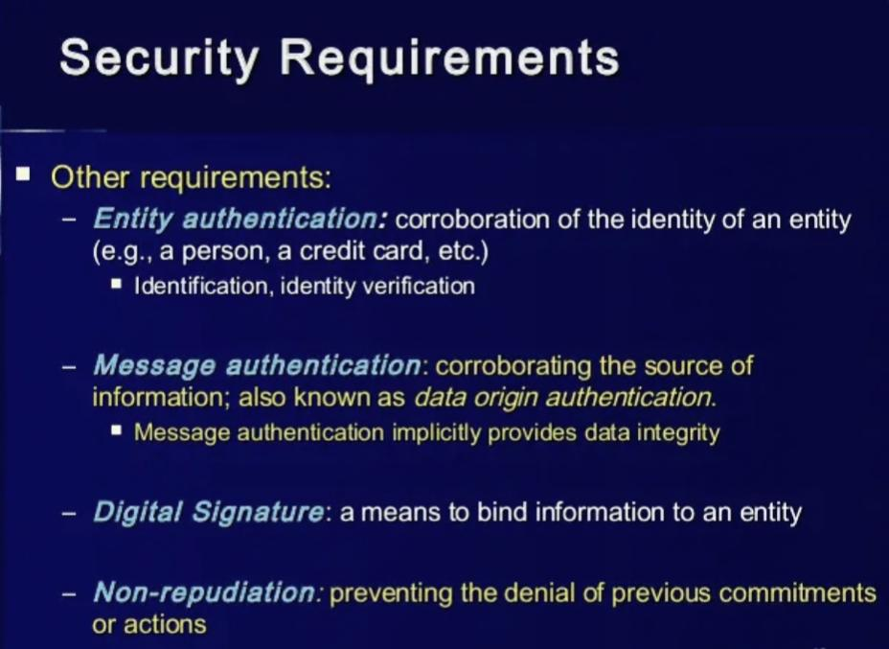

Slide 10
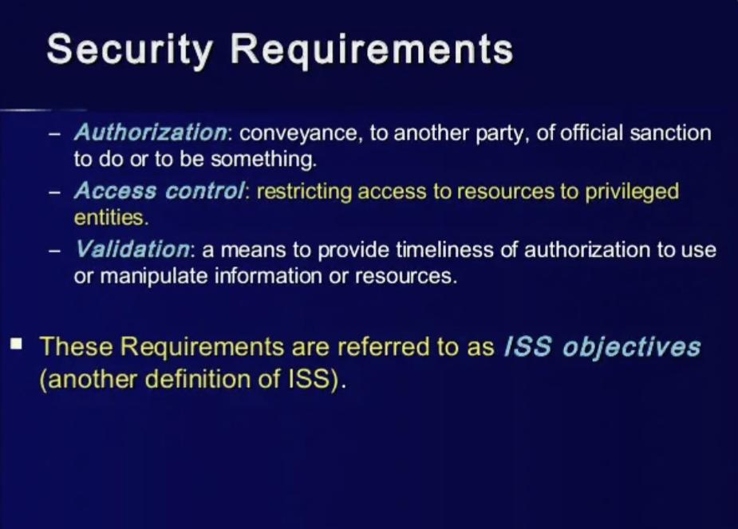

Slide 11
